Slide 1
Jermyn Borough Council Meeting
3/5/20

Slide 2
3/5/20
Meeting Agenda
Call to Order
Pledge of Allegiance
Roll Call
Previous Meeting Minutes
Bills Payable
Correspondence
Public Comment
CDBG Co-Op Resolution
Floodplain Management Ordinance
Fire Siren
Fire Companies
New Business
Adjournment

Slide 3

MS4 Minute

Slide 4

MS4 Minute

Slide 5
MS4 Minute

Slide 6

MS4 Minute

Slide 7

MS4 Minute

Slide 8
MS4 Minute

Slide 9
MS4 Minute

Slide 10
MS4 Minute

Slide 11
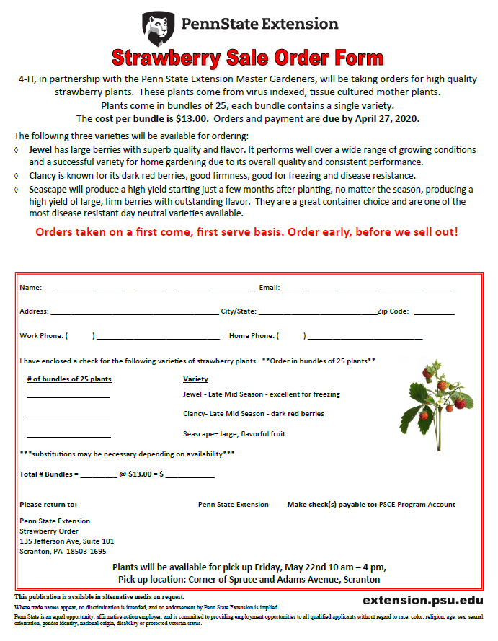
MS4 Minute

Slide 12

MS4 Minute

Slide 13
MS4 Minute

